Slide 1
Car Price Prediction

Slide 2
Problem Statement-
Data Collection-
Scrape at least 5000 used cars data from websites (Olx, cardekho, Cars24 etc.) using webscraping.
Model Building –
After collecting the data, you need to build a machine learning model.

Slide 3
Problem Understanding-
With the covid 19 impact in the market, we have seen lot of changes in the car market. Now some cars are in demand hence making them costly and some are not in demand hence cheaper. One of our clients works with small traders, who sell used cars. With the change in market due to covid 19 impact, our client is facing problems with their previous car price valuation machine learning models. So, they are looking for new machine learning models from new data. We have to make car price valuation model.

Slide 4
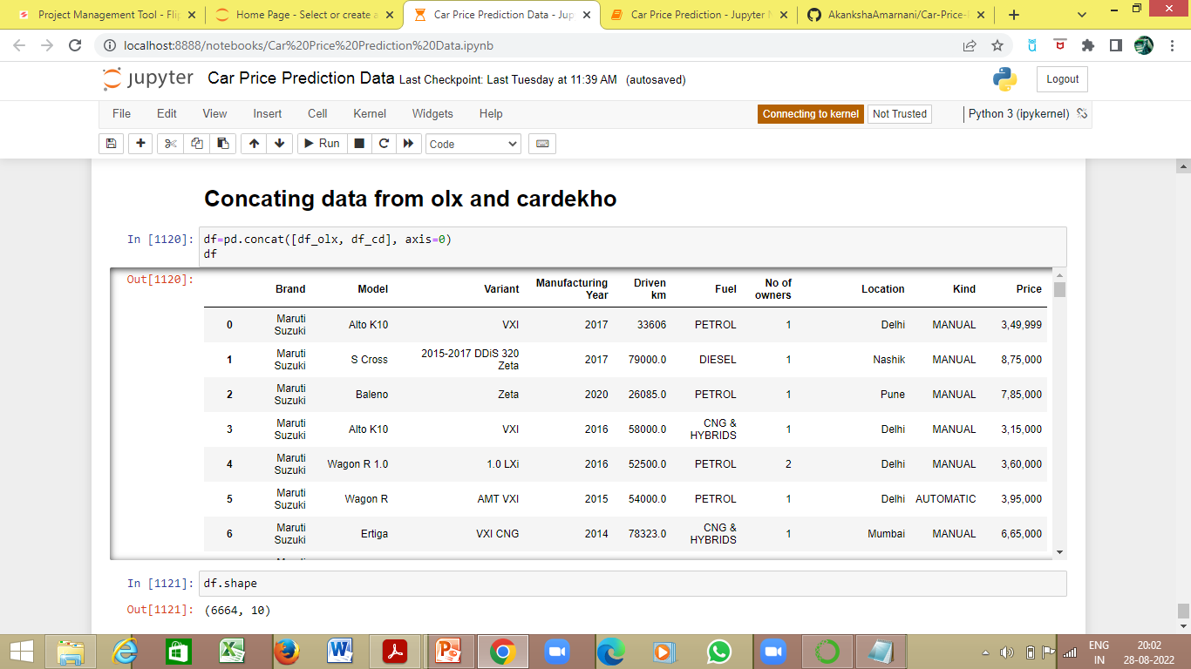
Data Collection
The data is scraped from 2 websites-
olx.com
Cardekho.com
From olx.com, the used car data is scraped based on the brands
From cardekho.com, the used car data is scraped based on their location
6664 used car data is scraped from both the websites.

Slide 5
Model Building
EDA Steps and Visualization

Slide 6
The web scraped data is saved onto an excel sheet
The excel datasheet is extracted and saved in a dataframe
The shape of the dataframe is checked-
There are 6664 rows and 10 columns
The columns are as follows-
Brand
Model
Variant
Manufacturing Year
Driven km
Fuel
No of owners
Location
Kind
Price

Slide 7
The data type of each column is-
Brand - object
Model - object
Variant - object
Manufacturing Year - float64
Driven km - object
Fuel- object
No of owners - object
Location - object
Kind - object
Price – object
The null values are checked. The whitespaces, and dashes (‘—’) are replaced by null values-
Variant - 179
Driven km - 22
Fuel- 32
No of owners - 5298
Kind - 92
As the No of owners is mostly consists of null values, the column is safe to be dropped

Slide 8
The data visualization, value counts encoding and imputation of null values for each column

Slide 9
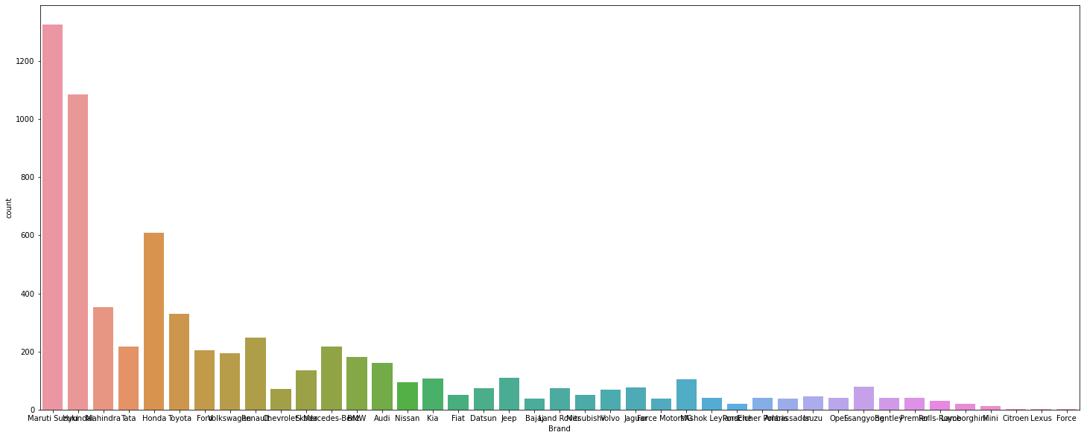
Brand
1325 used cars are Maruti Suzuki
1085 used cars are Hyundai
609 used cars are Honda
352 used cars are Mahindra
329 used cars are Toyota
247 used cars are Renault
218 used cars are Tata
217 used cars are Mercedes-Benz
204 used cars are Ford
194 used cars are Volkswagen
182 used cars are BMW
161 used cars are Audi
135 used cars are Skoda
109 used cars are Jeep
106 used cars are Kia
105 used cars are MG
95 used cars are Nissan
78 used cars are Ssangyong
76 used cars are Jaguar
74 used cars are Land Rover
73 used cars are Datsun
72 used cars are Chevrolet
69 used cars are Volvo
50 used cars are Fiat
50 used cars are Mitsubishi
45 used cars are Isuzu
40 used cars are Opel
40 used cars are Premier
40 used cars are Ashok Leyland
40 used cars are Bentley
40 used cars are Eicher Polaris
39 used cars are Bajaj
39 used cars are Ambassador
39 used cars are Force Motors
31 used cars are Rolls-Royce
21 used cars are Porsche
19 used cars are Lamborghini
13 used cars are Mini
1 used car is Citroen
1 used car is Lexus
1 used car is Force
Encoding object data in numeric using Label Encoder

Slide 10
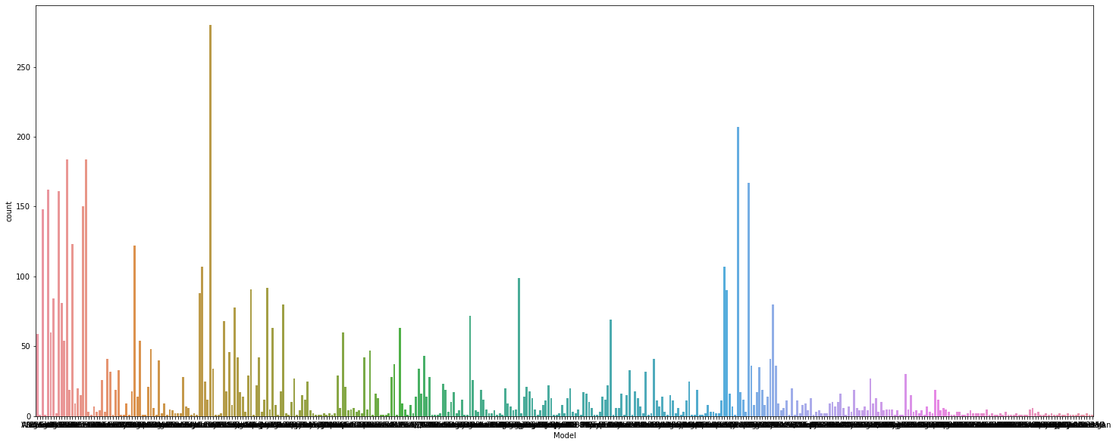
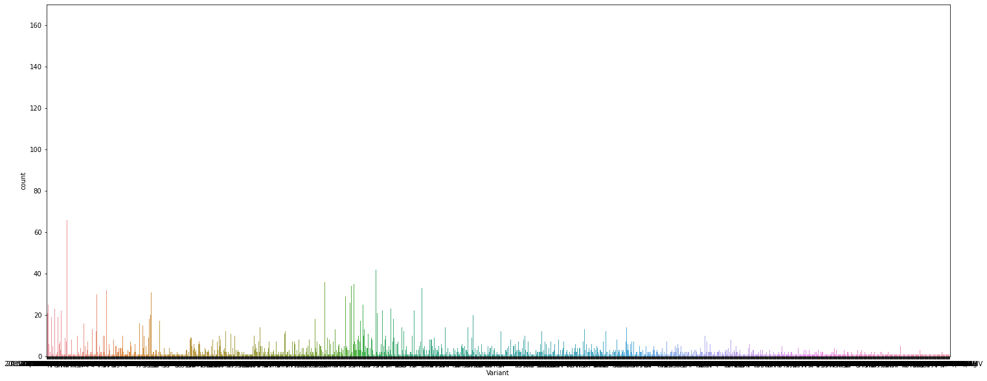
Model
Variant
Majority of the used cars are of the model City, i20, Swift, Creta and Grand i10
Majority of the used cars are of the model variant VXI, LXI, Sportz and VDI
Encoding object data in numeric using Label Encoder
Encoding object data in numeric using Label Encoder
Replacing wrongly encoded null value with null value

Slide 11
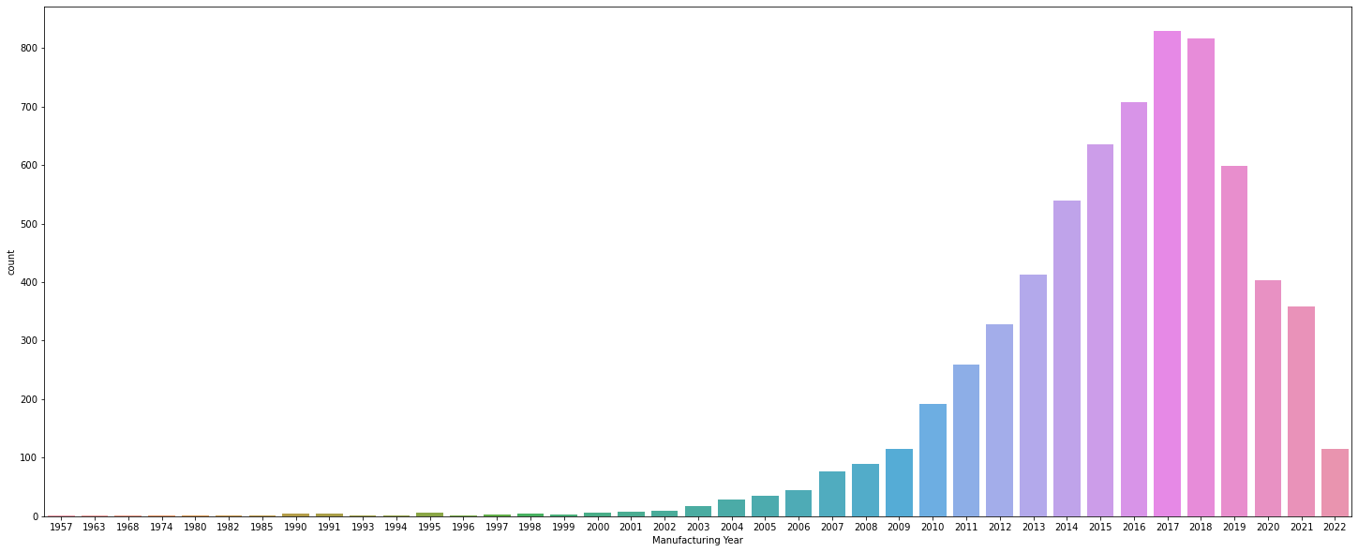
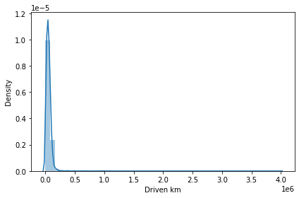
Manufacturing Year
Driven km
Converting Manufacturing Year to int data type
Converting Driven km to float data type
Majority of the used cars are manufactured between 2010-2020
92 used cars have driven for 70000km
The data is skewed and will be transformed later
The data is skewed and will be transformed later

Slide 12
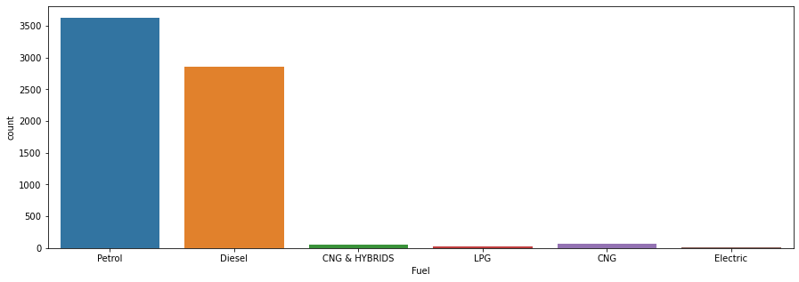
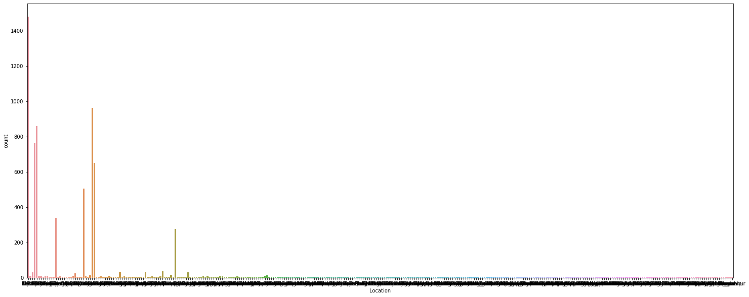
Fuel
Replacing Redundant data
Location
3626 used cars require Petrol as fuel
2858 used cars require Diesel as fuel
63 used cars require CNG as fuel
50 used cars require CNG & HYBRIDS as fuel
19 used cars require LPG as fuel
16 used cars require Electric as fuel
Majority of the used cars are available at Delhi, Bengaluru, Hyderabad, Mumbai, Chennai and Kolkata
Encoding object data in numeric using Label Encoder
Encoding object data in numeric using Label Encoder
Replacing wrongly encoded null value with null value

Slide 13
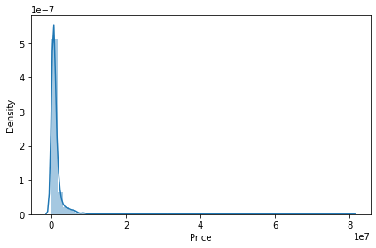
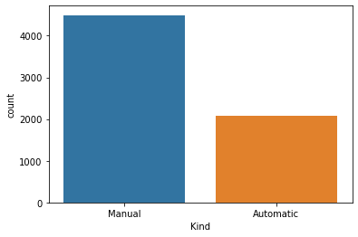
Kind
Price
Replacing Redundant data
Converting Price to float data type
4493 used cars are manual
2079 used cars are automatic
Majority of the used cars are being sold at a range of 4-6 Lakhs
Encoding object data in numeric using Label Encoder
The data is skewed and will be transformed later
Replacing wrongly encoded null value with null value

Slide 14
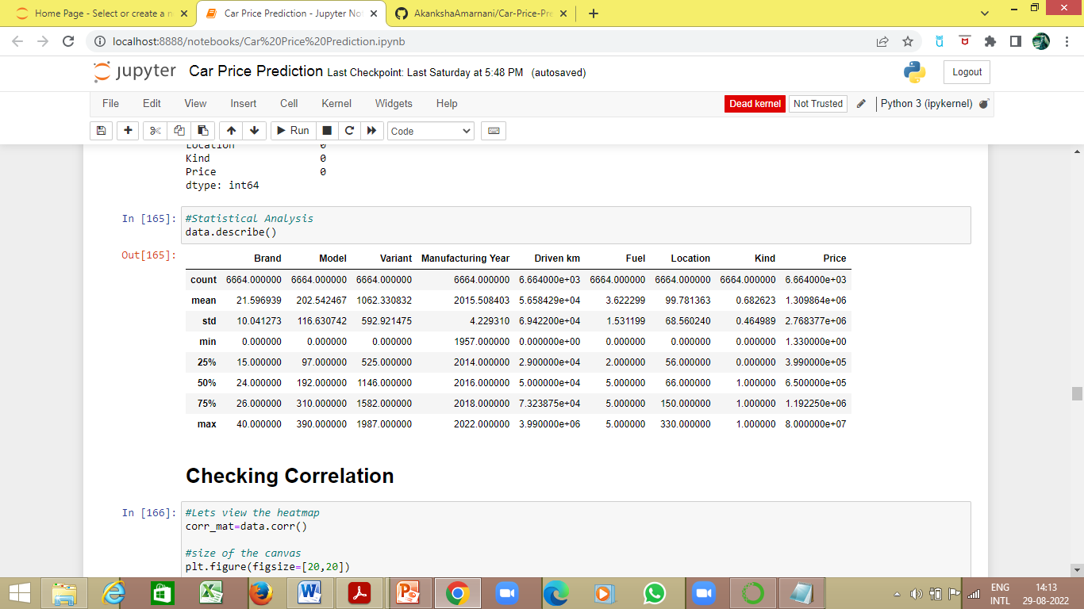
The null values in 'Variant ‘, ‘Driven km’, ‘Fuel’ and 'Kind ‘ are imputed using KNN Imputer.
Statistical analysis using describe method-

Slide 15
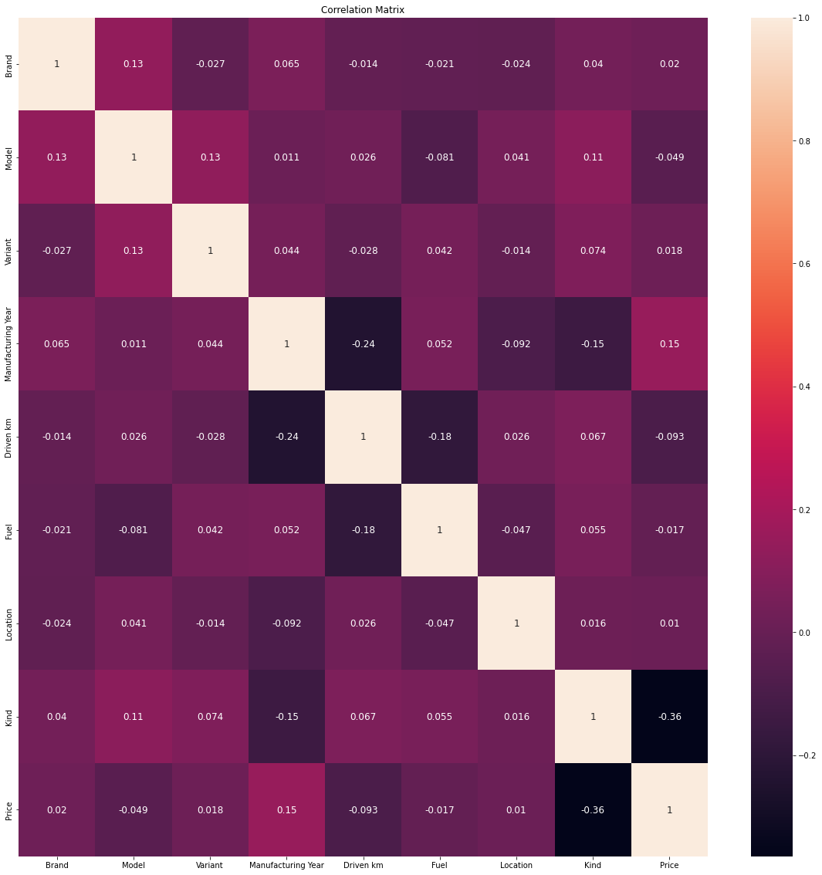
The Correlation Matrix using heatmap

Slide 16
Correlation between the columns and the label ‘Price’ using corr method-
Price : 1.000000
Manufacturing Year : 0.147913
Brand : 0.019558
Variant : 0.017863
Location : 0.010105
Fuel : -0.017235
Model : -0.049014
Driven km : -0.093212
Kind : -0.364608
Manufacturing Year is 14.79% positively correlated to ‘Price’
Brand is 1.95% positively correlated to ‘Price’
Variant is 1.78% positively correlated to ‘Price’
Location is 1% positively correlated to ‘Price’
Fuel is 1.72% negatively correlated to ‘Price’
Model is 4.94% negatively correlated to ‘Price’
Driven km is 9.32% negatively correlated to ‘Price’
Kind is 36.46% negatively correlated to ‘Price’

Slide 17
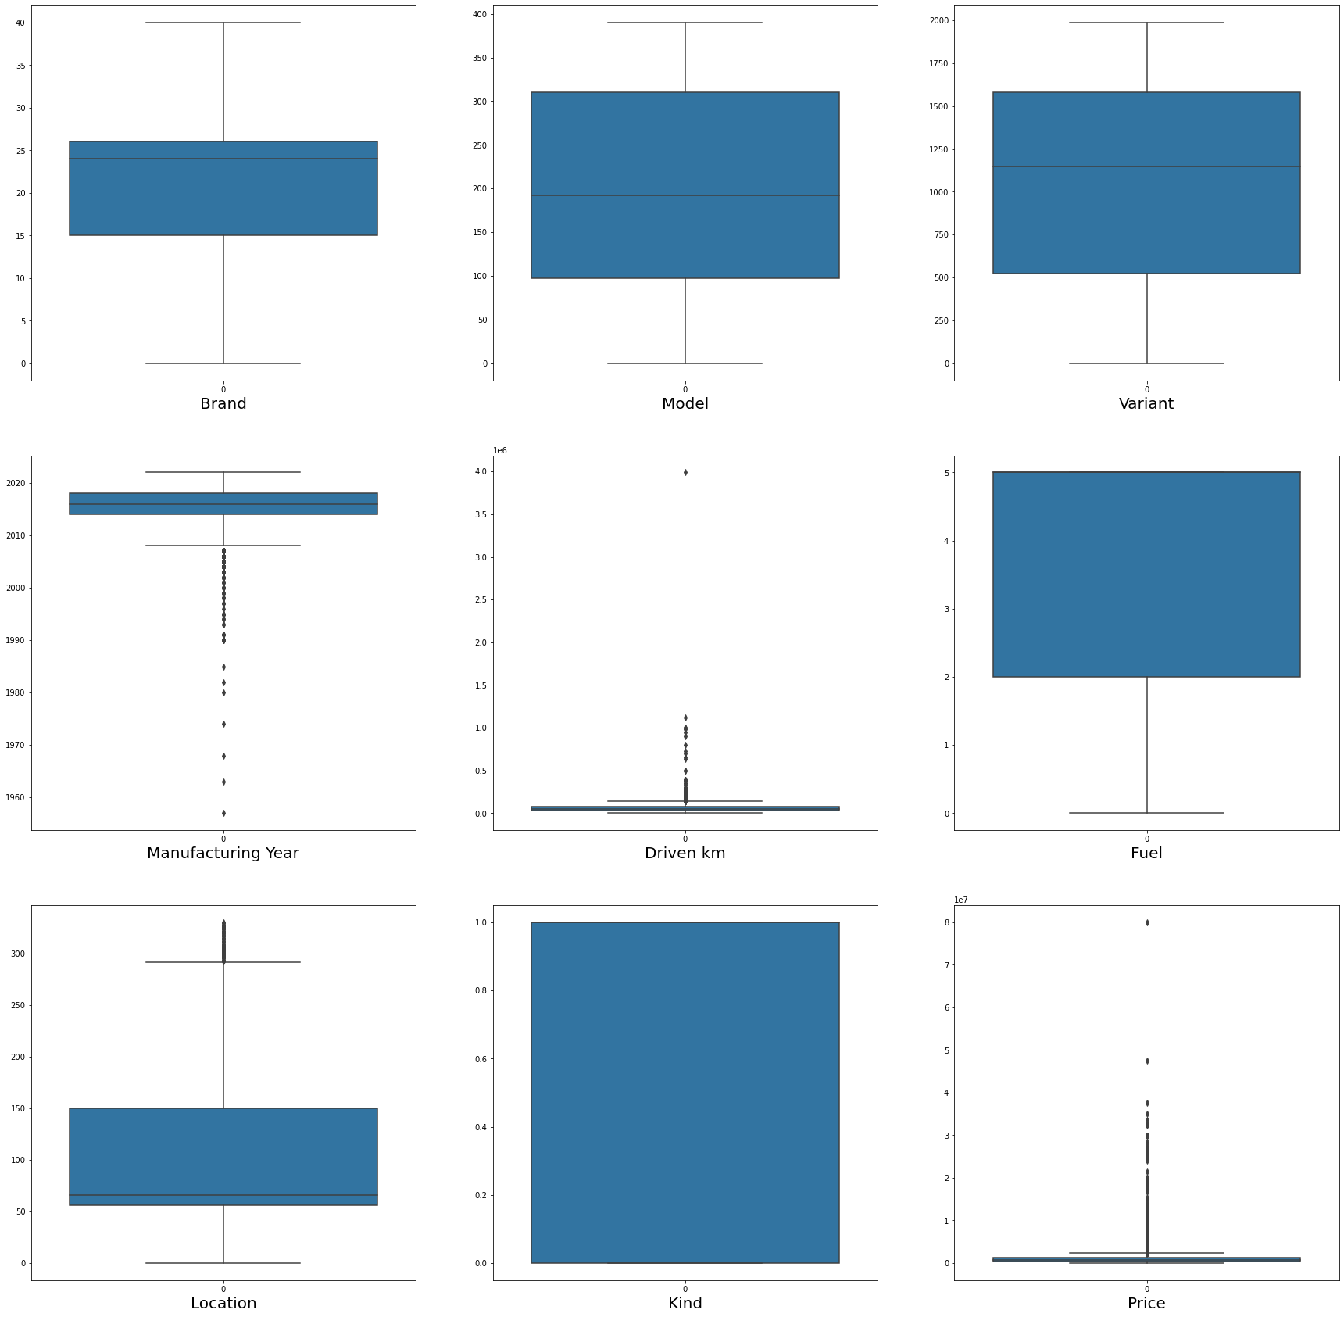
Visualizing outliers using boxplot method-

Slide 18
Removing outliers using zscore method-
On removing the outliers the data loss is 3%, which is acceptable, hence outliers are removed
The dataset is divided into x(features) and y (label)-
The x contains all the features other than the label ‘Price’
The y contains only the label ‘Price’

Slide 19
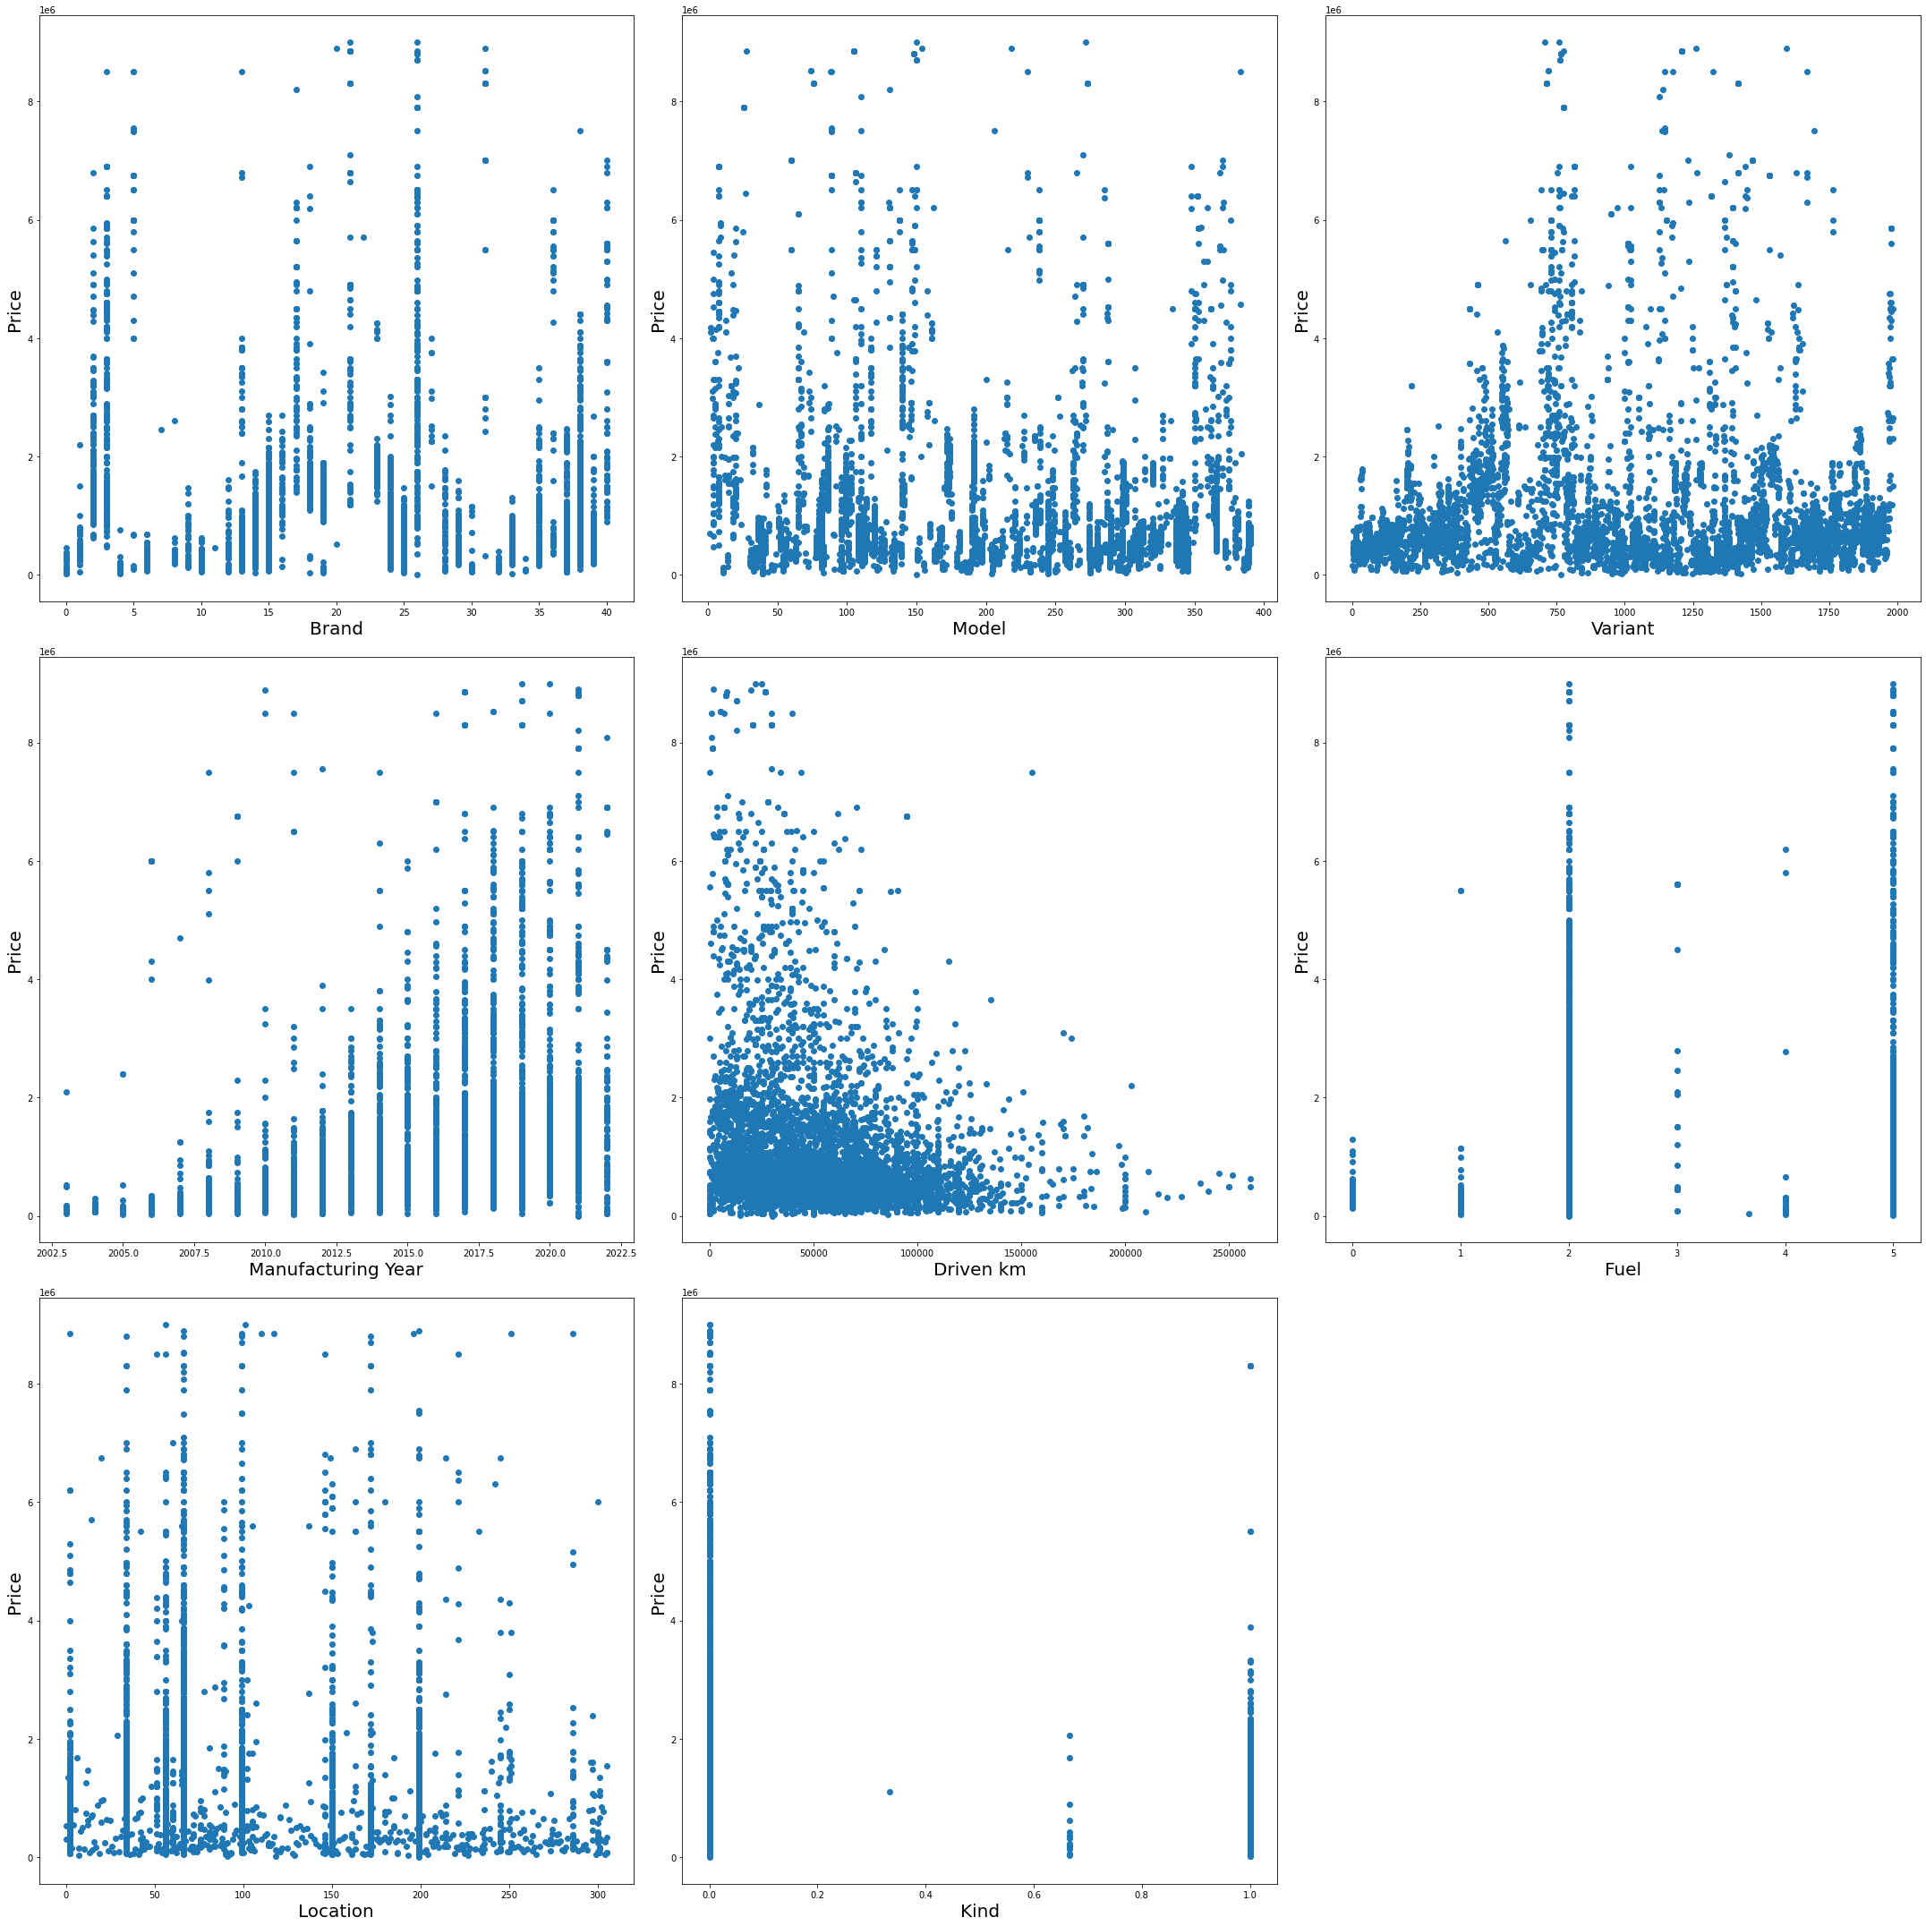
Visualizing relationship between features and label-

Slide 20
The skewness observed in graphical analysis was confirmed by using the skew method-
Driven km : 1.082297
Location : 0.801142
Model : 0.025468
Brand : 0.023501
Variant : -0.213326
Fuel : -0.277616
Manufacturing Year : -0.760945
Kind : -0.814154
This skewness was removed using the power transformer
The x(features) were scaled using the Standard Scaler
The dataset was divided into train and test set using train test split and the best random state was found to be 62

Slide 21
The train and test data were applied on different models as follows

Slide 22
Linear Regression Model
The R2 score for target test and pred_test(data predicted on features_test) is 37.61%
Upon cross-validation it was observed that the number of folds did not have such impact on the accuracy and cv score. So cv=9 is selected. Here we have handled the problem of the overfitting and the underfitting by checking the training and testing score
The graph between Actual Price and Predicted Price depicts the best fit line which passes through maximum of the points, hence suggesting that the model works well-

Slide 23
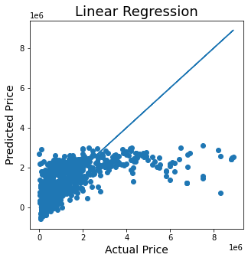

Slide 24
The Linear Regression Model is Lasso regularized with the aid of GridSearchCV
The best parameters for alpha and random_state are found as follows-
alpha: 10
random_state: 0
Applying the above found best parameters on Lasso regularized Linear Regression Model, the following was obtained-
R2 score for target_test and pred_test(data predicted on features_test) – 37.61%
CV score- 35.51%

Slide 25
Random Forest Regressor Model
Random Forest Regressor Model is hyperparameter tuned using GridSearchCV
The best parameters for criterion and max_features are found as follows-
criterion: mse
max_features: log2
Applying the above found best parameters on Random Forest Regressor Model, the following was obtained-
R2 score for target_test and pred_test (data predicted on features_test) –84.72%
CV score- 78.67%

Slide 26
Ada Boost Regressor Model
Ada Boost Regressor Model is hyperparameter tuned using GridSearchCV
The best parameters for n_estimators and learning_rate are found as follows-
learning_rate: 0.01
n_estimators: 93
Applying the above found best parameters on Ada Boost Regressor Model, the following was obtained-
R2 score for target_test and pred_test(data predicted on features_test) –40.82%
CV score- 37.83%

Slide 27
Model | R2 score for target_test and pred_test (data predicted on features_test) | CV score
Linear Regression Model | 37.61% | 35.51%
Random Forest Regressor Model | 84.72% | 78.67%
AdaBoost Regressor Model | 40.82% | 37.83%
The R2 score of Random Forest Regressor is 84.72% and CV score of Random Forest Regressor is 78.67%. This is the best working model and is finalized
This model can be used to predict the selling price of used cars.

